Slide 1
Digital Portfolio
STUDENT NAME: CHANDRU.S
REGISTER NO AND NMID: 24131090500121002 DD68F295608F39294B348AE850AE0DE7
DEPARTMENT: COMPUTER SCIENCE
COLLEGE: COLLEGE/ UNIVERSITY Thiruvallur arts and science college Annamalai University

Slide 2
PROJECT TITLE
Time less watch

Slide 3


AGENDA
Problem Statement
Project Overview
End Users
Tools and Technologies
Portfolio design and Layout
Features and Functionality
Results and Screenshots
Conclusion
Github Link
3/21/2024 Annual Review

Slide 4

PROBLEM STATEMENT
People struggle to find affordable yet luxurious watches.
Lack of platforms providing exclusive collections with easy browsing.
Customers demand premium design + modern shopping experience.

Slide 5

PROJECT OVERVIEW
Timeless Watches is an e-commerce platform for luxury watches.
Showcases brands, new arrivals, and offers.
Includes product details, reviews, gallery, and promotional features.

Slide 6

WHO ARE THE END USERS?
Watch enthusiasts
Luxury buyers
Gift shoppers
Fashion-conscious customers

Slide 7
TOOLS AND TECHNIQUES
Frontend: HTML, CSS, JavaScript
Backend (optional): Node.js / Django / PHP
Database (optional): MySQL / MongoDB
Hosting: GitHub Pages / Netlify / AWS

Slide 8
POTFOLIO DESIGN AND LAYOUT
Homepage with branding, search, navigation
Product details page (gallery, pricing, ratings, quantity selector)
Promotional section for offers
Responsive & mobile-friendly
‹#›

Slide 9
FEATURES AND FUNCTIONALITY
Product image gallery with thumbnail switching
Dynamic quantity selector (+/-)
“Add to Bag” button
Discounts and promotional offers
User reviews & star ratings

Slide 10
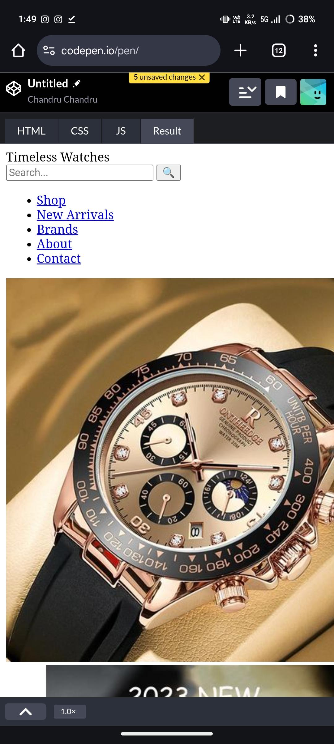

RESULTS AND SCREENSHOTS
3/21/2024 Annual Review
‹#›

Slide 11
CONCLUSION
Timeless Watches combines luxury with convenience.
Offers a premium shopping experience.
Scalable for future features (wishlist, payment gateway, brand collaborations)
https://github.com/chandru143212s-dotcom/Chandru-TNSDC-FWD-DP-.git
‹#›

